Slide 1

Unlocking the Power of AI for Handwritten Digits

Slide 2


Introduction
Understanding the potential of AI in recognizing is
crucial for advancing technology. This
presentation will explore the applications and challenges of using AI
for digit recognition.

Slide 3



History of Handwritten Digits Recognition
The history of
dates back to the 1950s when researchers began exploring pattern recognition. Over the years, advancements in AI and machine learning have revolutionized this ﬁeld.

Slide 4

AI Techniques for Digit
Recognition
Various AI techniques such as
and recurrent neural networks have shown remarkable success in accurately identifying handwritten digits.
Understanding these techniques is essential for leveraging their potential.

Slide 5



Challenges in Handwritten Digit Recognition
Despite signiﬁcant progress, challenges such as
and noisy data continue to pose obstacles in accurate digit recognition. Addressing these challenges is crucial for further advancements.

Slide 6
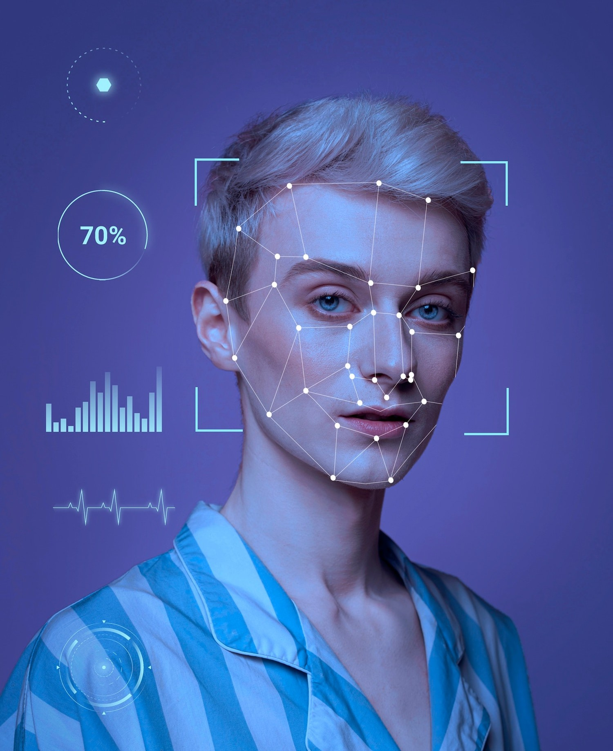






Applications of AI in Digit Recognition
The applications of AI for
extend across various
ﬁelds, including
, and
,
. Exploring these
applications can reveal the immense impact of AI in this domain.

Slide 7
Conclusion
Unlocking the power of AI for
holds immense potential for transforming industries and enhancing technological capabilities. Embracing the advancements in this ﬁeld can lead to groundbreaking innovations.

Slide 8
Thanks!
Do you have any questions? youremail@email.com
+91 620 421 838
www.yourwebsite.com @yourusername

